Slide 1
Introduction to HTML
Introduction to HTML | HTML Tags | Links
Notes:
Welcome to our lecture on HTML. In this lecture we will go through the introduction to html html tags and links.

Slide 2

Introduction to HTML
HTML (Hyper Text Markup Language) is a textual language for creating webpages. HTML files are usually saved with a .html or .html file extension.
HTML, CSS, and JavaScript are used together to create a webpage.
HTML, CSS, and JavaScript are used together to create a webpage.
HTML defines the structure and content of a webpage.
CSS specifies the layout and visible appearance.
JavaScript describes the dynamic behaviors and actions of a webpage.
Notes:
HTML or Hyper Text Markup Language is used to create webpages. HTML files are saved with a dot html extension. HTML works with CSS and JavaScript to build websites. HTML defines the structure and content, CSS handles the layout and appearance, and JavaScript manages dynamic behaviors. Together, they create a complete webpage experience.

Slide 3
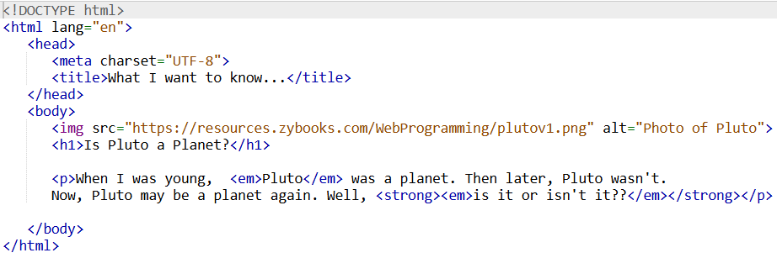
Sample HTML Code
Notes:
Here is a sample HTML code snippet. The HTML document starts with a DOCTYPE declaration followed by the html element. The head section includes a meta tag for character encoding and a title tag for the webpage title. The body section contains an image of Pluto, a heading asking if Pluto is a planet, and a paragraph discussing Pluto's planetary status with emphasis using the em and strong tags.

Slide 4
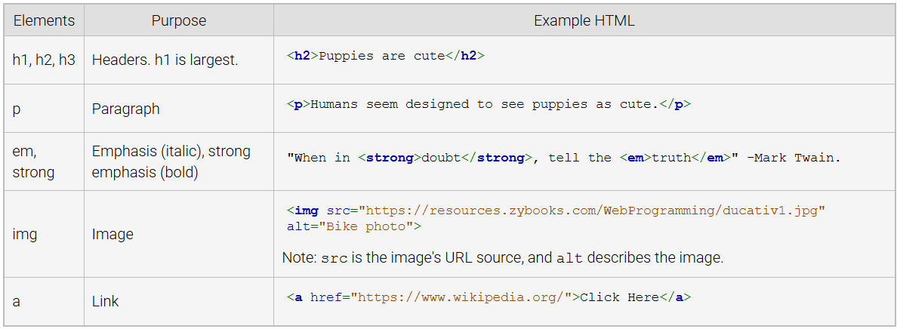
Common HTML Elements
Notes:
Let's explore common HTML elements. The h1, h2, h3 tags are used for headers, with h1 being the largest. The p tag defines paragraphs. The em tag adds emphasis with italics, while strong makes text bold. The img tag displays images using the src attribute for the image link and alt for description. The a tag creates hyperlinks with the href attribute for the link destination.

Slide 5
Introduction to Links
A link on a webpage is a clickable item that usually causes the web browser to open another webpage when clicked. Ex: Dear Photograph is a link to an interesting website. A button or image can also be a link.
A link is created with an anchor element.
The opening <a> tag uses the href attribute to specify the link's URL target.
The link text comes next and is followed by the closing </a> tag.
Notes:
Let's learn about links in HTML. A link on a webpage is a clickable item that redirects the browser to another webpage when clicked. Links are created using the anchor tag. The a tag uses the href attribute to specify the URL destination. The link text is placed between the opening and closing a tags, making it clickable. Links can also be added to buttons and images for navigation.

Slide 6
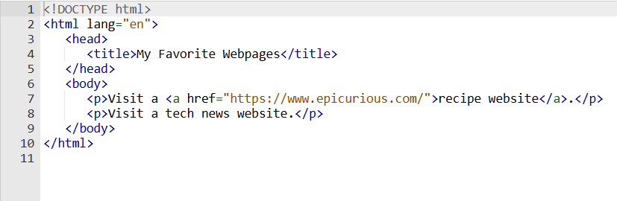
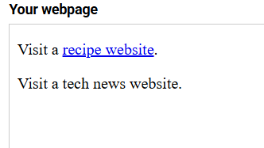
Introduction to Links
Notes:
"This slide shows an example of creating links using HTML. The a tag, also called the anchor tag, is used for hyperlinks. The href attribute defines the destination URL. In this example, a link to a recipe website is created with. The text between the tags becomes clickable, redirecting to the specified webpage when clicked."

